Slide 1

Oracle 11g: SQL
Chapter 3
Table Creation and Management

Slide 2
Objectives
Oracle naming rules
Create a new table using CREATE TABLE
Use a subquery to create a new table
Add a column to an existing table
Modify the definition of a column in an existing table
Delete a column from an existing table
Mark a column as unused (then delete it later)
Rename a table
Truncate a table
Drop a table
Oracle 11g: SQL

Slide 3
Creating & Modifying DB Objects
Only 3 Basic Actions
CREATE
ALTER
DROP
Notes:
CREATE – Build the structure – tables, indexes, views, sequences, etc.
ALTER – Modify the structure (not all) – only tables and sequences
DROP – Destroy the structure (hence all contents)
NO COMMIT or ROLLBACK

Slide 4
Oracle Naming Standard
Oracle database objects must adhere to the
Oracle Naming Standard
Notes:
1 to 30 characters long
Must begin with a letter
Can contain letters, digits, underscore (_), number sign (#), dollar sign($)
Cannot contain spaces
Cannot be a reserved word

Slide 5
Database Table
Fundamental database object that stores data for the database
Consists of columns and rows
Created and modified through Data Definition Language (DDL) commands
Oracle 11g: SQL

Slide 6

Table Design
Table and column names:
  Must adhere to Oracle Naming Standard
  Table name must be unique in the schema
  Column name must be unique in a table
Oracle 11g: SQL

Slide 7
Defining Columns
Column definition list must be in parentheses
Data type must be specified for each column
Maximum of 1,000 columns in a table
Oracle 11g: SQL

Slide 8
Data Fields & Types
5 keys to choosing the appropriate data type:
Notes:
Represent all possible values
Minimize excess storage space
Support all data manipulations
Enable data integrity rules
Support coding schemes, compression, encryption, etc.

Slide 9
Character / String Data Types
‘String values are in single quotes’
CHAR(n)
VARCHAR2
NCHAR, NVARCHAR2
Notes:
CHAR
Fixed-length of size n, Adds blank spaces to pad
Must specify width, up to 2000 (prev. 255)
prov_state CHAR(2)
VARCHAR2
Variable-length up to size n, No trailing blank spaces are added
Must specify maximum width, up to 4,000 (prev 2000)
student_name VARCHAR2(30)
NVARCHAR2, NCHAR
Supports 16-bit binary character codes (Unicode)
Used for alternate alphabets eg. Kanji

Slide 10
Number Data Types
NUMBER (precision, scale)
  column_name NUMBER(p,s)
internal storage type (integer, fixed point, floating point) determined by Oracle from precision and scale values
Notes:
Precision = total number of digits (both sides of the decimal point)
Scale = number of digits to right of decimal point

Slide 11
Number Data Types
Integer
Fixed point
Floating point (scientific notation)
Notes:
Integer numbers
Whole number, no decimals
Precision is maximum digits
student_age NUMBER(2) -99 to 99
Fixed point numbers
Contain a specific number of decimal places
Precision is maximum number of digits
Scale is number of decimal places
item_price NUMBER(5, 2) -999.99 to 999.99
stu_gpa NUMBER(3,2) -9.99 to 9.99
Floating point numbers (scientific notation)
No precision or scale
avagadro_nbr NUMBER e.g. 6.02 x 10²³

Slide 12
Date and Time Data Types
DATE
Stores both a date and time component
December 31, 4712 BC to December 31, 4712 AD
Default date format DD-MON-YY
Default time format HH:MI:SS A.M.
TIMESTAMP
  Similar to DATE but stores fractional seconds
Notes:
eg. stu_dob DATE
If only date value given, time default value is 12:00:00 AM
If only time value igiven, date default value is first day of current month
eg. phone_call_start TIMESTAMP

Slide 13
Date and Time Data Types
INTERVAL YEAR TO MONTH
Time interval, expressed in years and months
fieldname INTERVAL YEAR[(years)] TO MONTH
+02-11 is positive interval of 2 years, 11 months
INTERVAL DAY TO SECOND
Time interval, expressed in days, hours, minutes, and seconds
fieldname INTERVAL DAY[(leading_precision)] TO SECOND[(fractional_seconds_precision)]
-04 03:20:32.00 is negative interval of 4 days, 3 hours, 20 minutes, and 32 seconds

Slide 14
Large Object (LOB) Data Types
Stores ‘un-structured’ data along with columnar data
Cannot work much with these in SQL
  Set to NULL for INSERT or UPDATE
  Ask if IS NULL or IS NOT NULL in WHERE
  Can set one LOB to be the same value as another in UPDATE
Notes:
Text txt
Images jpg, gif, bmp
Sound wav
Video mpg
MS Office doc, xls, ppt

Slide 15
Large Object (LOB) Data Types
CLOB
BLOB
NCLOB
BFILE
Notes:
CLOB = Character (plain text only)
BLOB = Binary (anything not plain text)
NCLOB = 16-bit Character LOB
! up to 4GB in size
BFILE = ref to a binary file in o/s maintained storage
(be careful of pathnames!)
No size or width
item_image BLOB
audition_video BFILE

Slide 16
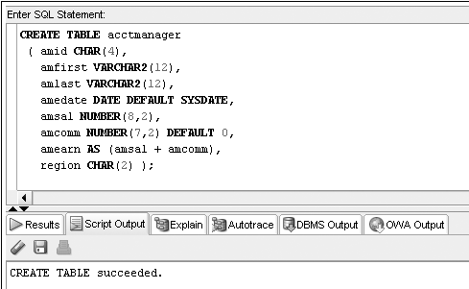
CREATE TABLE Command Example
Virtual Column
Oracle 11g: SQL

Slide 17
Viewing List of Your Tables: USER_TABLES
A data dictionary is a typical component of a DBMS that maintains information about database objects
You can query the data dictionary to verify all the tables that exist in your schema
The USER_TABLES data dictionary object maintains information regarding all your tables
Oracle 11g: SQL

Slide 18
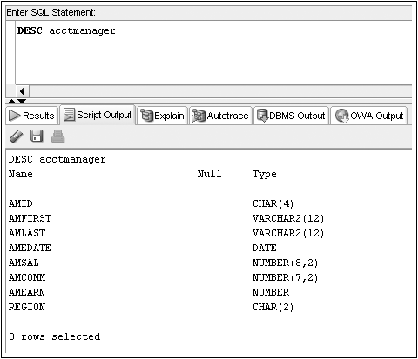
Viewing Table Structures: DESCRIBE
Displays the structure of a specified table

Slide 19
Table Creation through Subqueries
You can use subqueries to retrieve data from an existing table
Requires use of AS keyword
New column names can be assigned
Oracle 11g: SQL
Notes:
Like a ‘Make Table’ Action Query in MS Access

Slide 20
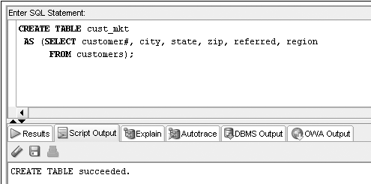
CREATE TABLE…AS Command Example
Oracle 11g: SQL

Slide 21
Modifying Existing Tables
Accomplished through the ALTER TABLE command
Use an ADD clause to add a column
Use a MODIFY clause to change a column
Use a DROP COLUMN to drop a column
Oracle 11g: SQL

Slide 22
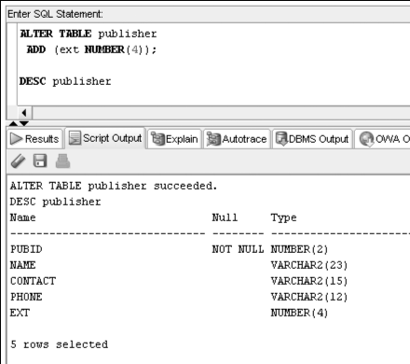

Slide 23
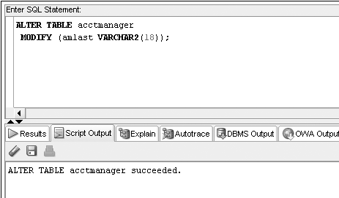
Oracle 11g: SQL

Slide 24
Modification Guidelines
Column must be as wide as any data it already contains
If a NUMBER column already contains data, size cannot be decreased
Adding or changing DEFAULT value does not affect existing data
Oracle 11g: SQL

Slide 25
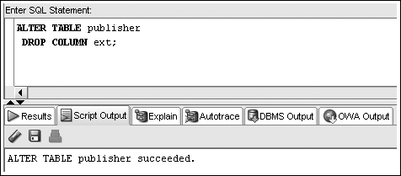
ALTER TABLE…DROP COLUMN
Can only reference one column per execution
Deletion is permanent
Cannot delete last remaining column in a table
Oracle 11g: SQL

Slide 26
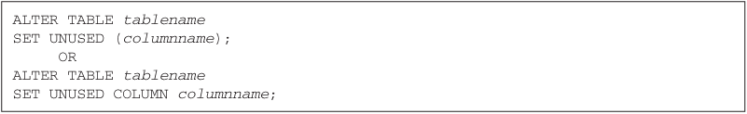
ALTER TABLE…SET UNUSED
Once marked for deletion, a column cannot be restored
Storage space is freed at a later time
Oracle 11g: SQL

Slide 27
ALTER TABLE…DROP UNUSED
Frees up storage space from columns previously marked as unused
Oracle 11g: SQL

Slide 28
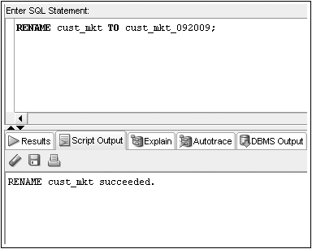
Renaming a Table
RENAME <old name> TO <new name>
- the old name is no longer valid
Oracle 11g: SQL

Slide 29
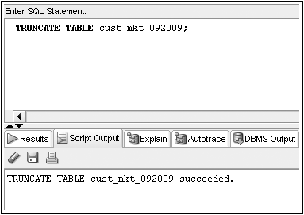
Truncating a Table
TRUNCATE TABLE
  All rows are deleted (no rollback, so fast)
  Structure of table remains
Oracle 11g: SQL
Notes:
Usually to empty out results of repeated test runs

Slide 30
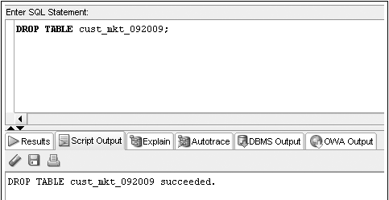
Deleting a Table
DROP TABLE command
  Table structure and contents are deleted
Oracle 11g: SQL

Slide 31
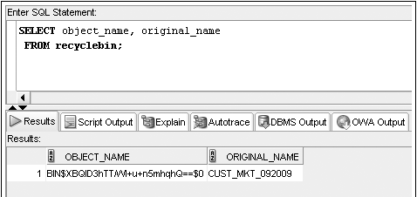
Recycle Bin (new in 10g)
Dropped tables can be recovered from the recycle bin using FLASHBACK command
Oracle 11g: SQL

Slide 32
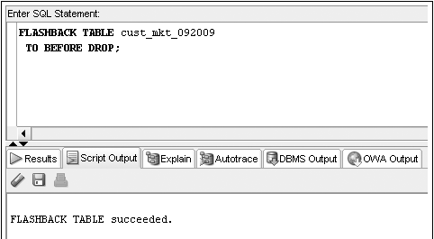
FLASHBACK Command
The FLASHBACK command recovers a table from the recycle bin
Oracle 11g: SQL

Slide 33
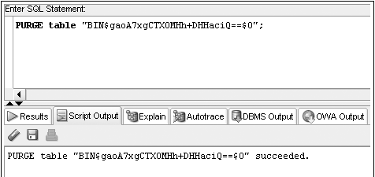
PURGE Command
Purge removes a table from the recycle bin
Oracle 11g: SQL

Slide 34

DROP TABLE … PURGE Command
Using the PURGE option will permanently remove a table from the database
The table will not be copied into the recycle bin
Oracle 11g: SQL

